Slide 1

CSE 5311: Algorithm Design and Analysis
Traveling Salesman Problem is
NP-Complete
by
Vaishnavi Balasubramanya
ID: 1000-58-3834

Slide 2
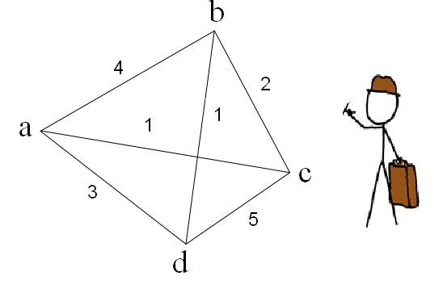
Traveling Salesman Problem
In the traveling salesman problem, a salesman must visit n cities.
Salesman wishes to make a tour visiting each city exactly once and finishing at the city he started.
There is an integer cost c(i,j) to travel from city i to city j.
For example, the salesman must travel to a, b, c, d locations.
Travel costs are given

Slide 3
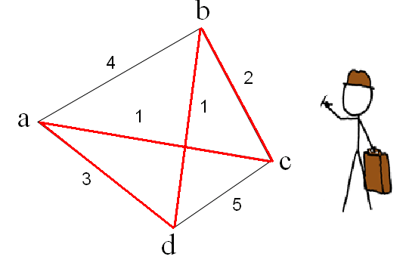
Traveling Salesman Problem
The salesman wishes to make the tour whose total cost is minimum.
The total cost is sum of the individual costs along the edges of the tour
In the example the minimum cost tour is a-c-b-d-a
The cost of this tour is 1+2+1+3 = 7

Slide 4
Traveling Salesman Problem
The formal language:
TSP = { <G,c,k>: G=(V,E) is a complete graph, c is a function from VxV->Z, k ∈ Z and G has a traveling salesman tour with cost at most k}
Next we see that a fast algorithm for the traveling salesman problem is unlikely to exist.

Slide 5
TSP is NP-complete
To show that TSP is NP-complete we first show that TSP belongs to NP.
Given an instance of the problem the certificate is the sequence of n vertices (cities) in the tour.
The certifier (verification algorithm) checks that
  this sequence contains each vertex exactly once,
  sums up the edge costs and checks whether the sum is at most k.
This process can be done in polynomial time.

Slide 6
TSP is NP-complete
To prove that TSP is NP-hard we show that Ham-cycle ≤ _{p} TSP.
Let G=(V,E) be an instance of Ham-cycle.
We construct an instance of TSP as follows
  Form the complete graph G' = (V,E') where E' = { (i,j) : i, j ∈ V and i≠j} and
  Define the cost function c by c(i,j) = { 0 if (i,j) ∈ E, 1 if (i,j) ∉ E }

Slide 7
TSP is NP-complete
Note that G is undirected, it has no self loops and hence c(u,u) = 1 for all v ∈ V
The instance of TSP is then <G',c,0> which is easily formed in polynomial time.
We now show that graph G has a Hamiltonian cycle if and only if graph G' has a tour of cost at most 0.
Suppose the graph G' has a Hamiltonian cycle h.
Each edge in h belongs to E and thus has a cost 0 in G'
Thus h is a tour in G' with cost 0

Slide 8
TSP is NP-complete
Conversely suppose that graph G' has a tour h' of cost at most 0.
Since the cost of edges in E' are 0 and 1, the cost of tour h' is exactly 0 and each edge on the tour must have cost 0.
Thus h' contains only edges in E.
Hence we conclude that h' is a Hamiltonian cycle in graph G.

Slide 9
Applications of Traveling Salesman Problem
Printed circuit manufacturing: Planning the most efficient motion of a robotic arm that drills holes in n points on the surface of a VLSI chip.
Serving I/O requests on a disk.
Sequencing the execution of n software modules to minimize the context switching time.

Slide 10
Zero Weight Cycle
Jonathan Cross

Slide 11
The Problem
Given a directed graph G = (V,E) with weights w_{e} on its edges e ∈ E. The weights can be positive or negative. The Zero-Weight-Cycle Problem is to decide if there is a simple cycle in G so that the sum of the edge weights on this cycles is exactly 0.
1
-6
5
-2
-3
-3

Slide 12
Is ZWC ∈ NP?
Verify a given solution in polynomial time.
Simple: Traverse the solution and verify the sum is zero.
1
1
0
-6
5
-2
-5
-3
-3

Slide 13
Reduction
To a believed NP Complete Problem: Subset Sum
Via Section 8.8 we believe the Subset Sum to be NP Complete: S = {a₁,a₂,…,a_{n}} & W
Construct G₀ with vertices {v_{i}, u_{i}} as equal to each a_{i} in S.
    S = {1,-2,-3,5,-3,-6}; n = 6;
1
-6
5
-2
-3
-3

Slide 14
Reduction
S = {1,-2,-3,5,-3,-6}; n = 6;
Construct a weighted Graph G₀ with 2n vertices.
  Each a_{i} has vertices v_{i} and u_{i}
    Add zero weight edges to each v_{i} from all u_{j}
    Add zero weight edges to each u_{i} from all v_{j}
    Total Number of edges = 2n(n-1) + n
  Summing a traversal equivalent to an examination for a subset in a subset sum problem.
  If there exists a zero weight cycle in G then all weights from u_{i} to v_{i} must sum to zero.
G₀
1
1
1
2
2
-2
3
3
-3
4
4
5
5
5
-3
6
6
-6
v
u
Zero weight edge

Slide 15
Reduction
  Construct a cycle by picking all edges corresponding to the element in S₀ and connect those edges by those zero weight edges and finally obtain a zero weight cycle.
1
1
1
2
2
-2
1
-3
3
3
-6
5
4
4
5
-2
-3
5
5
-3
-3
6
6
-6
v
u
Zero weight edge

Slide 16
Solution
First, given a simple cycle in G, we can determine whether the sum of its edge
weights is zero in polynomial time. Thus Zero-Weight-Cycle 2 NP.
Then we reduce the Subset Sum Problem to this problem. The subset sum problem is: given
A set of integers, determine whether the sum of some non-empty subset equal exactly zero.
Consider a set of integers S = {a₁, . . . , a_{n}}, we construct a weighted directed graph G with 2n
Vertices, such that every element a_{i} corresponds to two vertices v_{i} and u_{i}.
For each v_{i}, add an edge from v_{i} to u_{i} with weight a_{i} and add edges from every vertex u_{j} to it with weight 0.
For each u_{i}, add edges from this vertex u_{i} to every other v_{j} with weight 0.
If we find a zero-weight-cycle in G, then all the weights from v_{i} to u_{i} along the cycle must be zero.
If we get a subset S₀ which sums to zero, we construct a cycle by picking all edges (v_{i}, u_{i}) corresponds to the element in S₀ and connect those edges by those zero weight edges and finally obtain a zero weight cycle.
Thus this problem is at least as hard as subset sum problem. Since the subset problem is NP-complete, we have Zero-Weight-Cycle 2 NPC.

Slide 17

Foreground/Background
Image Segmentation
Paul Doliotis

Slide 18
What is our goal?
To label each pixel in an image as belonging to either the foreground of the scene or the background
Solution?
This problem can be solved efficiently by a minimum cut computation.

Slide 19
Likelihood and separation parameters
For each pixel i we have a likelihood ai that it belongs to the foreground and a likelihood bi that it belongs to the background.
We can label a pixel i as belonging to the foreground
if ai > bi, and to the background otherwise.
We must also consider a pixel’s neighbours. If many neighbours are in the background we would be more inclined to label i as background. Thus, for each pair(i,j) of neighbouring pixels there is a separation penalty pij >= 0 if both pixels don’t belong to foreground or background.

Slide 20
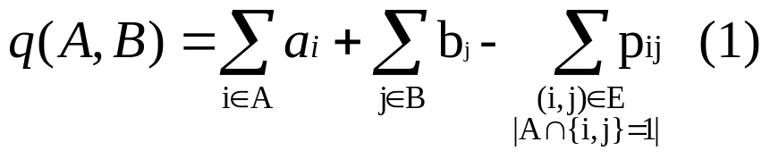
We can define our Segmentation Problem as finding an partition of the set of pixels into sets A and B (foreground and background respectively) so as to maximize the following sum:
Defining our problem mathematically
This is a maximization problem though. Minimum cut algorithm is a minimization problem

Slide 21
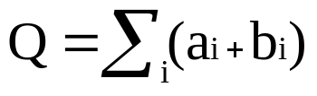
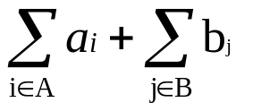
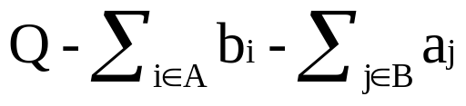
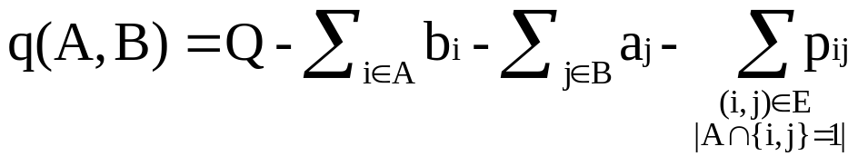
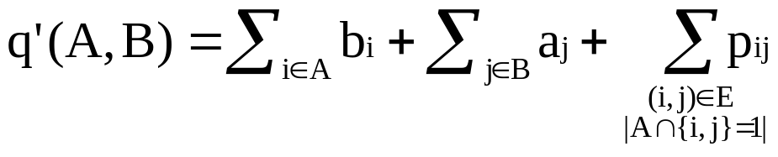
Converting our problem to a minimum cut problem
In equation (1) we are defining a maximization problem. We must modify (1) to make our problem a minimization problem.
Let . The sum: equals
. As a result we can rewrite (1) as:
. Maximizing q(A,B) is the
same as minimizing q’(A,B):

Slide 22
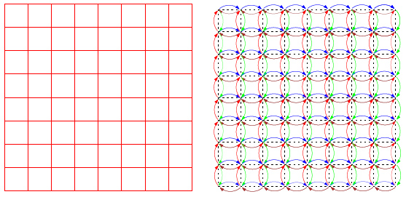
Constructing our graph (1)
Let V be the set of pixels and E to denote the set of all pairs of neighbouring pixels. We obtain an undirected graph G=(V,E).

Slide 23
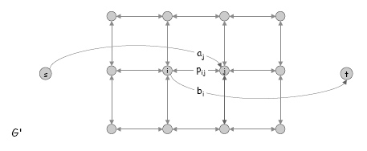
Constructing our graph (2)
We create a source node s to represent the foreground and a sink node t to represent the background. We attach each of s and t to every pixel and use ai, bi for capacities between pixel i and the source and sink respectively.
For each pair (i,j) we create instead of one undirected, two directed edges (i,j) and (j,i) with capacity pij (separation parameter)

Slide 24
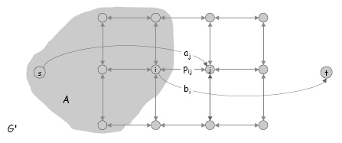
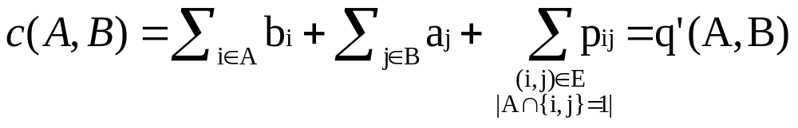
Minimum cut(A,B)
An s-t cut(A,B) is a partition of our pixels into sets A (foreground) and B (background).
Edges (s,j), jєΒ contribute aj capacity to the cut
Edges (i,t), iєA contribute bi capacity to the cut
Edges (i,j), iєA jєΒ contribute pij capacity to the cut
If we add these contributions we get:

Slide 25
An Application of Maximum Flow:
The Baseball Elimination Problem
We are given the following tournament situation:
Note: No ties are allowed. Each win gives one point.
Question: Is Harvard eliminated or not?
(A team is eliminated if it can’t be the first or tied for the first
at the end of the tournament).
Mayur
Mayur
Motgi
w(i)‏
g(i)‏
g(i,j)‏
Team
Wins
To play
Y
H
C
B
Yale
33
8
1
6
1
Harvard
29
4
1
0
3
Cornell
28
7
6
0
1
Brown
27
5
1
3
1

Slide 26
The Baseball Elimination Problem:
Preliminary Analysis
The maximum number of points Harvard can get is
W = 29 + 4 = 33 (by winning all its games)‏
Suppose Harvard wins all its remaining games.
It will not be eliminated if and only if
  Brown has no more than u(B) = W-w(B) = 33-27 = 6 wins in the remaining games;
  Cornell has no more than u(C) = W-w(C) = 33-28 = 5 wins in the remaining games;
  Yale has no more than u(Y) = W-w(Y) = 33-33 = 0 wins in the remaining games.
Let P be the set of all the teams other than Harvard: P = {Y, C, B}
Let Q be the set of all possible pairs of P-teams:
Q = { (Y,C), (Y,B), (C,B) }
The total number of games to be played between P-teams is
G = 6+1+1 = 8 .

Slide 27
Solving the Baseball Elimination Problem via Maximum Flow
The baseball elimination problem can be solved by creating and solving a related instance of maximum flow problem:
  Create a source node O (all the games originate here).
  Create a node for each pair from Q; for each Q-node (i, j), add an arc from O to (i, j); the arc’s capacity is the number of games to be played between i and j.
  Create a node for each team from P; for each Q-node (i, j), add arcs from (i ,j) to P-nodes i and j; cap( (i,j)→i ) = cap( (i,j)→j ) = cap( O →(i,j) ) .
  Create sink node T (the wins of the teams are recorded here).
  Add an arc from any P-node j to T; the capacity of the arc is u(j) .
6
Y,C
Y
0
6
6
1
1
5
O
Y,B
C
T
1
1
1
6
C,B
1
B

Slide 28
Solving the Baseball Elimination Problem via Maximum Flow
  Find the maximum flow from O to T in the resulting network.
  If maximum flow value = G (total number of remaining games among P-teams)
  then Harvard still has chances to be number one,
  else Harvard is eliminated.
  (that is, if all the games can be played so that teams Y, C, B get no more than u(Y), u(C), u(B) wins correspondingly, then Harvard still can be number one).
For our example, the bold red numbers on the arcs show the optimal flow values.
  Since the maximum flow value is 7 < 8 = G, Harvard is eliminated.
6
Y,C
Y
0
6
5
6
1
5
1
1
5
5
O
Y,B
C
T
1
1
1
2
1
1
6
C,B
1
1
B

Slide 29
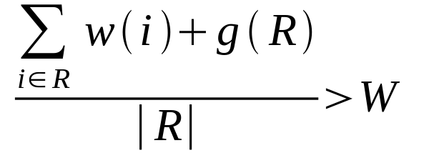
Showing the elimination of Harvard using minimum-cut-based arguments
Below is a different way to show the elimination of Harvard.
The team nodes on the O-side are Y and C.
The total number of wins between Y and C is (33 + 28) + 6 = 67.
Then the average number of wins is 67 / 2 = 33.5 .
This means that one of Y and C will certainly get ≥ 34 points.
So Harvard is eliminated with its maximum possible 33 points.
Generally, suppose we have teams 0, 1,…, n.
If there is a set of teams R ⊆{1,…,n} such that
(g(R) = total number of games to be played among R)‏
then team 0 is eliminated.

Slide 30
Showing the elimination of Harvard using minimum-cut-based arguments
The O-side of the minimum cut is {O, (Y,C), Y, C} (the set of the nodes that are reachable from O via augmenting paths)‏
The team nodes on the O-side are Y and C.
The number of games to be played between Y and C is 6.
But the maximum number of total wins for Y and C,
that allows Harvard to be number one, is 0+5 = 5.
Thus, Harvard is eliminated.
Claim: If team 0 is eliminated,
then R = team nodes on the O-side of the minimum cut.
6
Y
Y,C
0
Min cut
5
6
6
1
5
1
1
5
5
T
O
Y,B
1
C
1
1
2
1
1
6
C,B
1
1
B

